Slide 1
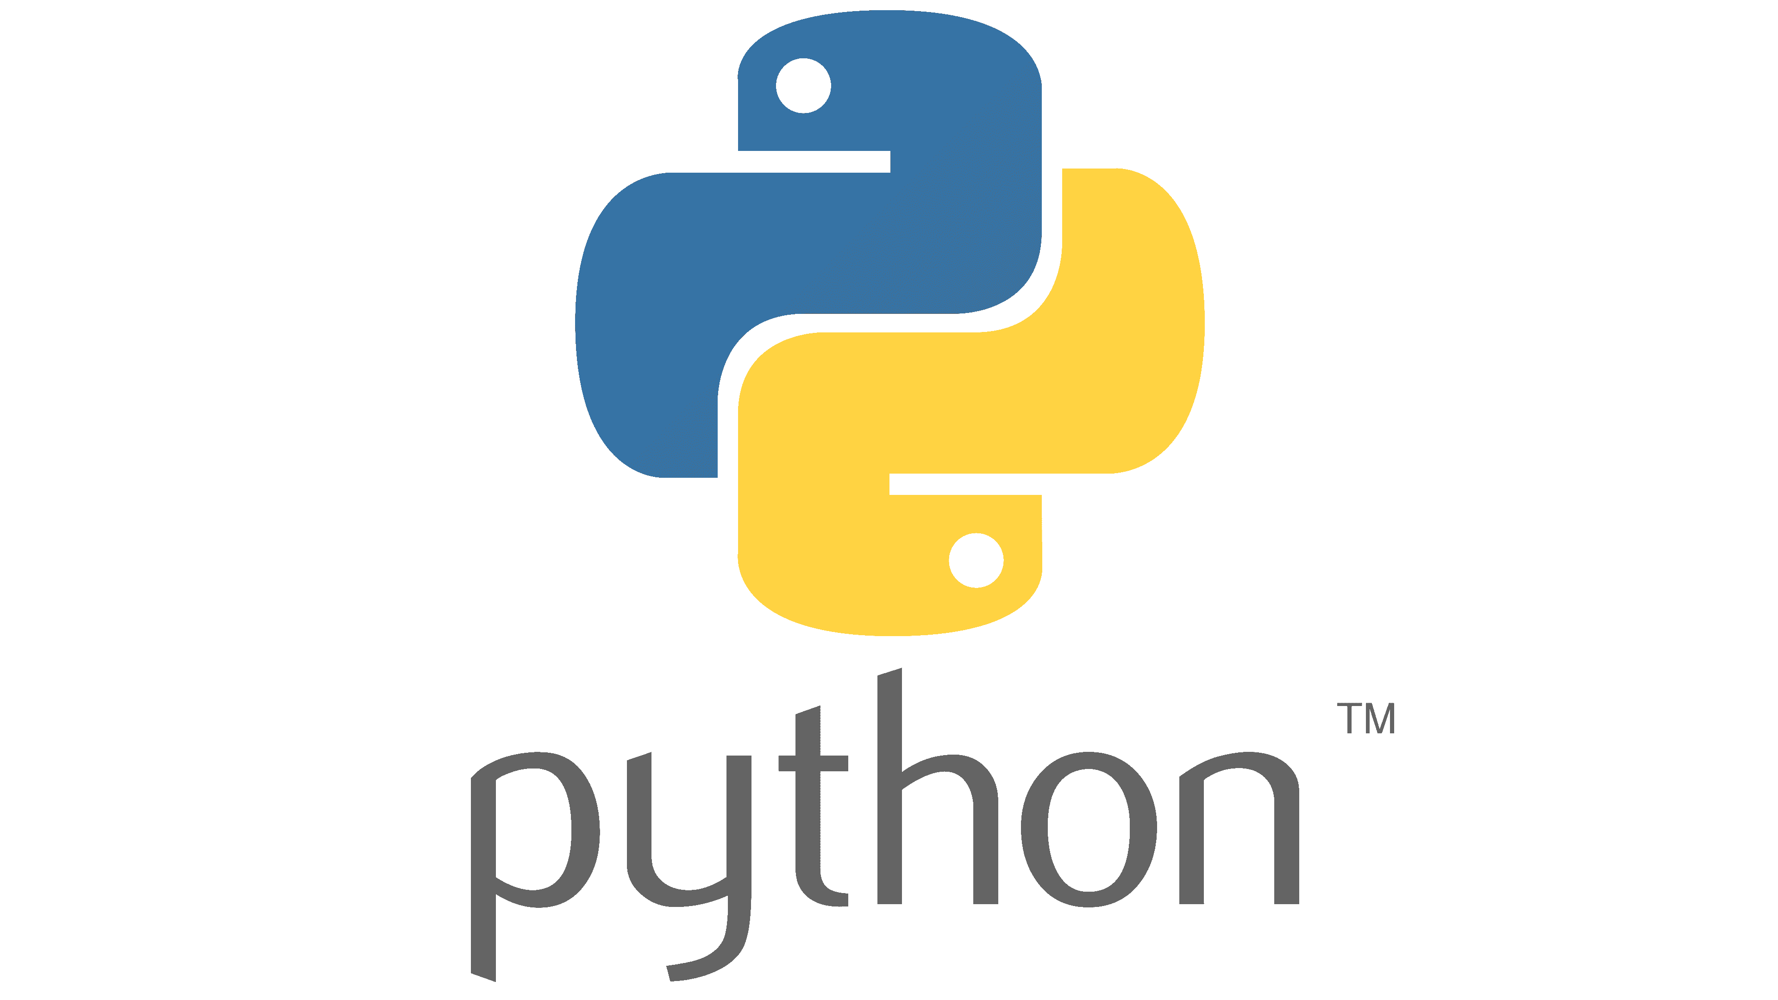
Introduction to python Session # 1
Prepared by Kheir el dine Baarini

Slide 2
Outline
What is python?
Why python
What python is used for ?
Environment
Variables

Slide 3
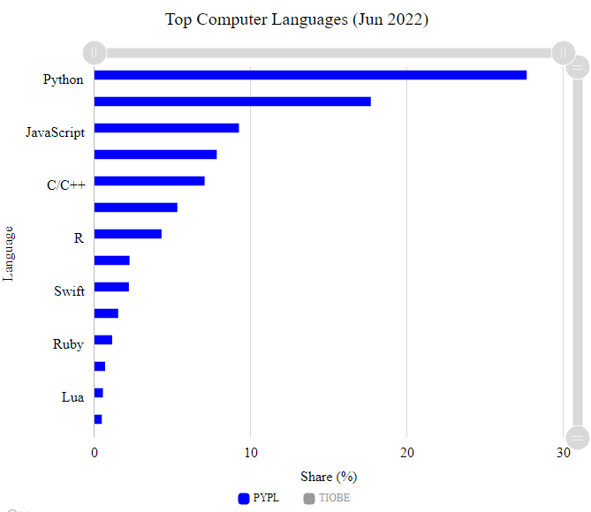
What is python?
Python is a computer programming language often used to build websites and software, automate tasks, and conduct data analysis. Python is a general-purpose language, meaning.
27.61 %

Slide 4
Why Python?
Easy to Learn and Use
Mature and Supportive Python Community
Support from Renowned Corporate Sponsors
Hundreds of Python Libraries and Frameworks
Versatility, Efficiency, Reliability, and Speed
Big data, Machine Learning and Cloud Computing
First-choice Language
The Flexibility of Python Language
Use of python in academics
It is interpreted

Slide 5
What is python used for ?
1. AI and machine learning
2. Data analytics
3. Data visualization
4. Programming applications
5. Web development
6. Game development
7. Language development
8. Finance
9. SEO
10. Design

Slide 6
Environment
Python 3.10 https://www.python.org/downloads/
IDE
List of IDEs
IDLE
PyCharm https://www.jetbrains.com/pycharm/download/
Visual Studio Code
Atom
Jupyter

Slide 7




Before we start
Python Indentation
Indentation refers to the spaces at the beginning of a code line.
Where in other programming languages the indentation in code is for readability only, the indentation in Python is very important.
Python uses indentation to indicate a block of code.

Slide 8



Before we start
The number of spaces is up to you as a programmer, the most common use is four, but it has to be at least one.
You have to use the same number of spaces in the same block of code, otherwise Python will give you an error:
Example

Slide 9
Hello World Program
Open your editor
Create a new file
Add:
print("Hello, World!")
Run

Slide 10
Comments
#This is a comment print("Hello, World!")
print("Hello, World!") #This is a comment
A comment does not have to be text that explains the code, it can also be used to prevent Python from executing code:
#print("Hello, World!") print("Cheers, Mate!")

Slide 11
Multi Line Comments
Python does not really have a syntax for multi line comments.
To add a multiline comment, you could insert a # for each line:
#This is a comment #written in #more than just one line print("Hello, World!")
Or, not quite as intended, you can use a multiline string.
Since Python will ignore string literals that are not assigned to a variable, you can add a multiline string (triple quotes) in your code, and place your comment inside it:
""" This is a comment written in more than just one line """ print("Hello, World!")

Slide 12
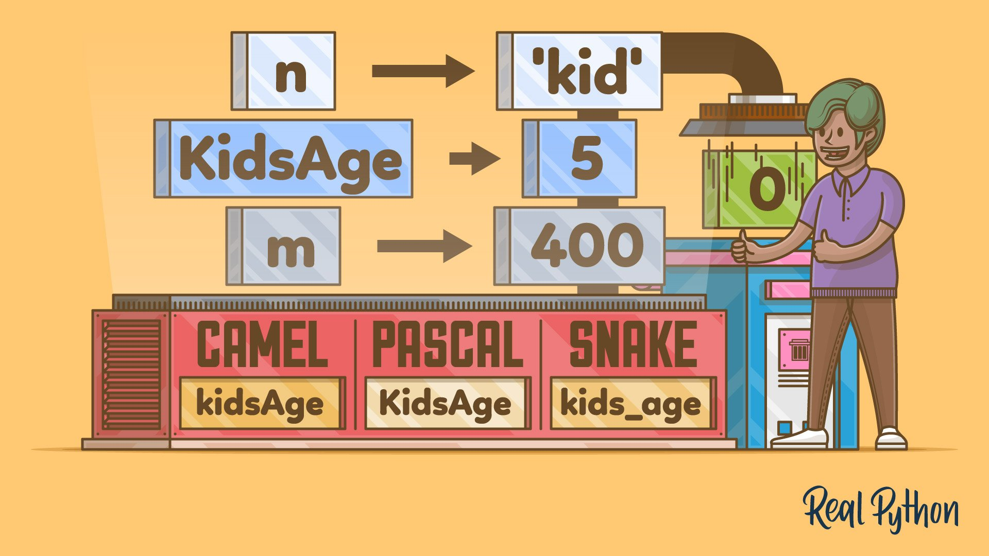
Python Variables
Variables are containers for storing data values.

Slide 13
Creating Variables
Python has no command for declaring a variable.
A variable is created the moment you first assign a value to it.
x = 5 y = "John" print(x) print(y)
Casting
If you want to specify the data type of a variable, this can be done with casting.
x = str(3) # x will be '3' y = int(3) # y will be 3 z = float(3) # z will be 3.0

Slide 14
Get the Type
You can get the data type of a variable with the type() function.
Case-Sensitive
x = 5 y = "John" print(type(x)) print(type(y))
a = 4 A = "Sally" #A will not overwrite a
Single or Double Quotes?
String variables can be declared either by using single or double quotes:
x = "John" # is the same as x = 'John'

Slide 15
Variable Names
A variable can have a short name (like x and y) or a more descriptive name (age, carname, total_volume). Rules for Python variables:
A variable name must start with a letter or the underscore character
variable name cannot start with a number
A variable name can only contain alpha-numeric characters and underscores (A-z, 0-9, and _ )
Variable names are case-sensitive (age, Age and AGE are three different variables)
myvar = "John" my_var = "John" _my_var = "John" myVar = "John" MYVAR = "John" myvar2 = "John"
2myvar = "John" my-var = "John" my var = "John"

Slide 16
Multi Words Variable Names
Variable names with more than one word can be difficult to read.
There are several techniques you can use to make them more readable:
Camel Case
Each word, except the first, starts with a capital letter:
myVariableName = "John
Snake Case
Each word is separated by an underscore character:
my_variable_name = "John"
Pascal Case
Each word starts with a capital letter:
MyVariableName = "John"

Slide 17
Assign Multiple Values
Many Values to Multiple Variables
Python allows you to assign values to multiple variables in one line:
x, y, z = "Orange", "Banana", "Cherry" print(x) print(y) print(z)
One Value to Multiple Variables
And you can assign the same value to multiple variables in one line:
x = y = z = "Orange" print(x) print(y) print(z)
fruits = ["apple", "banana", "cherry"] x, y, z = fruits print(x) print(y) print(z)
Unpack a Collection
If you have a collection of values in a list, tuple etc. Python allows you to extract the values into variables. This is called unpacking.

Slide 18

Output Variables
You can also use the + operator to output multiple variables:
You can also use the + operator to output multiple variables:
The Python print() function is often used to output variables.
x = "Python " y = "is " z = "awesome" print(x + y + z)
x = "Python" y = "is" z = "awesome" print(x, y, z)
x = "Python is awesome" print(x)
x = 5 y = "John" print(x + y)
x = 5 y = 10 print(x + y)

Slide 19
Global Variables
x = "awesome" def myfunc(): x = "fantastic" print("Python is " + x) myfunc() print("Python is " + x)
Variables that are created outside of a function (as in all of the examples above) are known as global variables.
Global variables can be used by everyone, both inside of functions and outside.
The global Keyword
Normally, when you create a variable inside a function, that, variable is local and can only be used inside that function.
To create a global variable inside a function, you can use the global keyword.
x = "awesome" def myfunc(): global x x = "fantastic" myfunc() print("Python is " + x)
def myfunc(): global x x = "fantastic" myfunc() print("Python is " + x)
To change the value of a global variable inside a function, refer to the variable by using the global keyword:

Slide 20
Data Types

Slide 21
Data Types
Python has the following data types built-in by default, in these categories:
Text Type: | str
Numeric Types: | int, float, complex
Sequence Types: | list, tuple, range
Mapping Type: | dict
Set Types: | set, frozenset
Boolean Type: | bool
Binary Types: | bytes, bytearray, memoryview
None Type: | NoneType

Slide 22
Examples
x = "Hello World" | str
x = 20 | int
x = 20.5 | float
x = 1j | complex
x = ["apple", "banana", "cherry"] | list
x = ("apple", "banana", "cherry") | tuple
x = range(6) | range
x = {"name" : "John", "age" : 36} | dict
x = {"apple", "banana", "cherry"} | set
x = frozenset({"apple", "banana", "cherry"}) | frozenset
x = True | bool
x = b"Hello" | bytes
x = bytearray(5) | bytearray
x = memoryview(bytes(5)) | memoryview
x = None | NoneType

Slide 23
Setting the Specific Data Type
x = str("Hello World") | str
x = int(20) | int
x = float(20.5) | float
x = complex(1j) | complex
x = list(("apple", "banana", "cherry")) | list
x = tuple(("apple", "banana", "cherry")) | tuple
x = range(6) | range
x = dict(name="John", age=36) | dict
x = set(("apple", "banana", "cherry")) | set
x = frozenset(("apple", "banana", "cherry")) | frozenset
x = bool(5) | bool
x = bytes(5) | bytes
x = bytearray(5) | bytearray
x = memoryview(bytes(5)) | memoryview

Slide 24
Python Numbers
Type Conversion
There are three numeric types in Python:
int
float
complex
x = 1 # int y = 2.8 # float z = 1j # complex #convert from int to float: a = float(x) #convert from float to int: b = int(y) #convert from int to complex: c = complex(x) print(a) print(b) print(c) print(type(a)) print(type(b)) print(type(c
x = 1 # int y = 2.8 # float z = 1j # complex
x = 3+5j y = 5j z = -5j print(type(x)) print(type(y)) print(type(z))
x = 1.10 y = 1.0 z = -35.59 print(type(x)) print(type(y)) print(type(z))
x = 35e3 y = 12E4 z = -87.7e100 print(type(x)) print(type(y)) print(type(z))

Slide 25
Casting
x = int(1) # x will be 1 y = int(2.8) # y will be 2 z = int("3") # z will be 3
int() - constructs an integer number from an integer literal, a float literal (by removing all decimals), or a string literal (providing the string represents a whole number)
float() - constructs a float number from an integer literal, a float literal or a string literal (providing the string represents a float or an integer)
str() - constructs a string from a wide variety of data types, including strings, integer literals and float literals
x = str("s1") # x will be 's1' y = str(2) # y will be '2' z = str(3.0) # z will be '3.0'
x = float(1) # x will be 1.0 y = float(2.8) # y will be 2.8 z = float("3") # z will be 3.0 w = float("4.2") # w will be 4.2

Slide 26
Strings
Strings
Strings in python are surrounded by either single quotation marks, or double quotation marks.
'hello' is the same as "hello".
You can display a string literal with the print() function:
print("Hello") print('Hello')
Assign String to a Variable
Assigning a string to a variable is done with the variable name followed by an equal sign and the string:
a = "Hello" print(a)

Slide 27
Thank You

